Slide 1
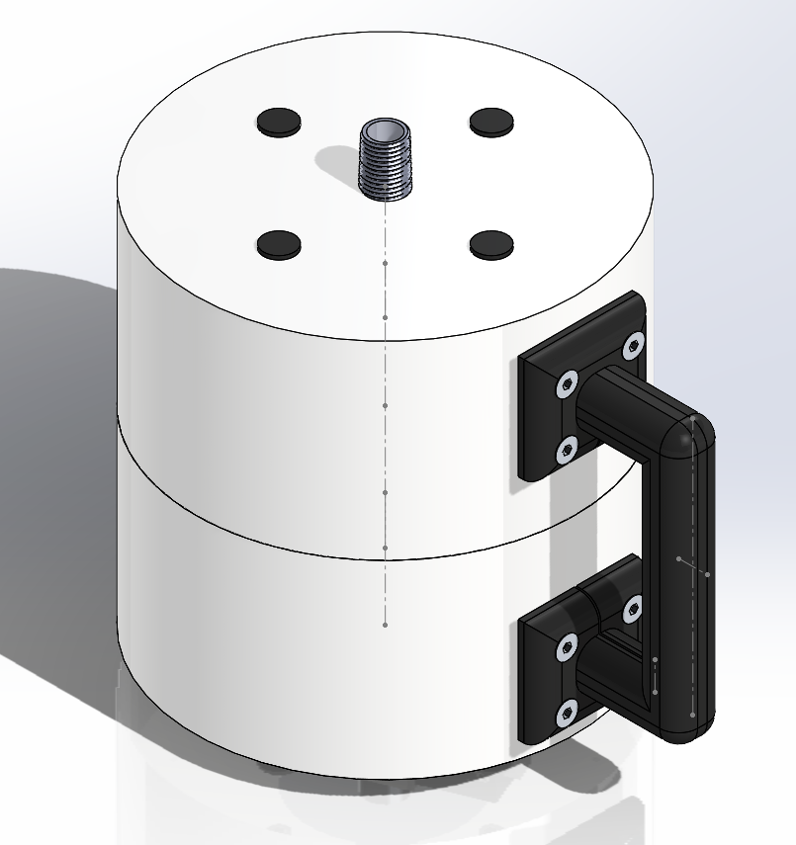
Our Design
Lightweight
Portable
Robust
Safe

Slide 2
Competitor Designs
Take digestate to the instrument

Slide 3
Competitor Designs
Take digestate to the instrument
Slow Loss of temperature, need to reheat to maintain correct state Risk of spillage

Slide 4
Competitor Designs | Our Design
Take digestate to the instrument | Take the instrument to the digestate
Slow Loss of temperature, need to reheat to maintain correct state Risk of spillage

Slide 5
Competitor Designs | Our Design
Take digestate to the instrument | Take the instrument to the digestate
Slow Loss of temperature, need to reheat to maintain correct state Risk of spillage | Efficient Safe, no exposure to pathogens or gases

Slide 6
The concept
Screwed into bioreactor release valves

Slide 7
The concept
Screwed into bioreactor release valves
Modular valve heads

Slide 8
The Design
Lightweight, hard plastic outer shell
Comfortable rubber grip
Well sized 20 cm diameter round container
Total unit height of 24 cm
Expected weight of 2.5kg
Battery operated, 24 hours before requiring recharging
Designed for easy assembly and servicing

Slide 9
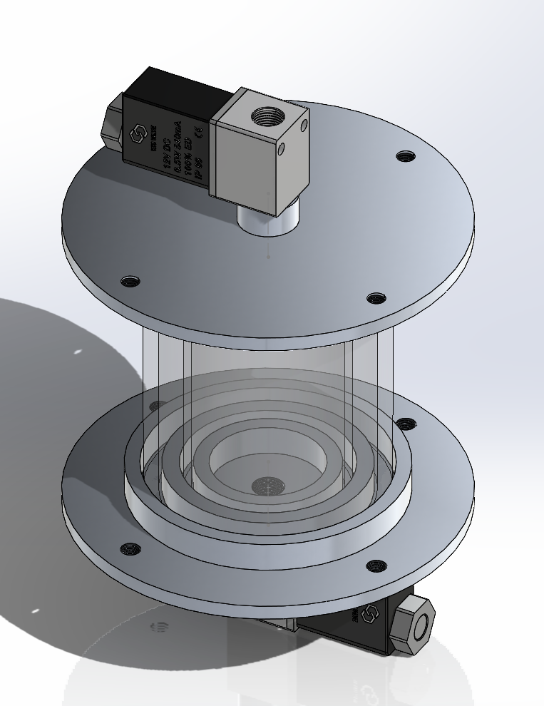
Inner Digestate Container

Slide 10
Inner Digestate Container
Immediately testable
Foaming will be representative of the foaming in the reactor
No direct user interaction with digestate

Slide 11
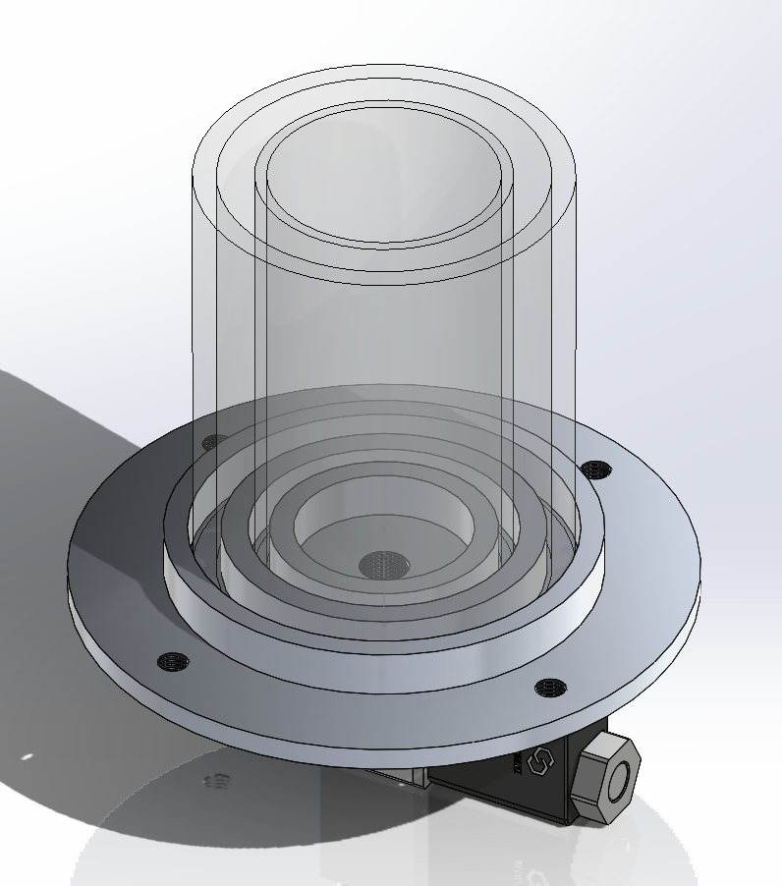
Inner Digestate Container
Thick glass outer layer
Thin glass inner layer
Sealed gap of air
100 ml of digestate will fill up to the halfway point of the glass container

Slide 12
Inner Digestate Container
Thick glass outer layer
Thin glass inner layer
Sealed gap of air
100 ml of digestate will fill up to the halfway point of the glass container
Major Benefits
Strong
Insulates digestate and maintains in the mesophilic state without any heating.

Slide 13
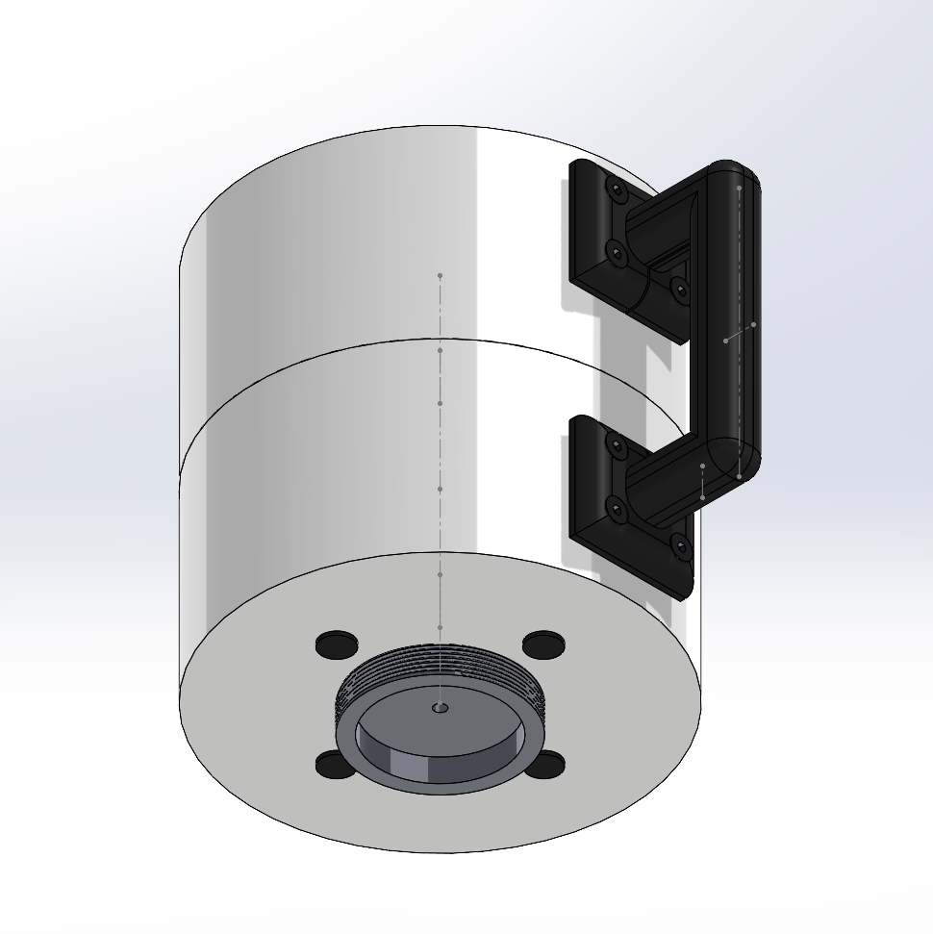
Disposal of Tested Digestate
Simple
Fast
No direct interactions required
Safe

Slide 14
Disposal of Tested Digestate
Screw in a digestate waste bag to the bottom of the unit

Slide 15
Disposal of Tested Digestate
Screw in a digestate waste bag to the bottom of the unit
Select “dispose of digestate”

Slide 16
Disposal of Tested Digestate
Screw in a digestate waste bag to the bottom of the unit
Select “dispose of digestate”
Seal, remove, and dispose of.

Slide 17
Other Design benefits over competitors

Slide 18
Other Design benefits over competitors
No flat surface required

Slide 19
Other Design benefits over competitors
No flat surface required
Cannot be interrupted from knocks or movement, screwed into place

Slide 20
Other Design benefits over competitors
No flat surface required
Cannot be interrupted from knocks or movement, screwed into place
Does not require heating, insulation keeps the digestate warm for length of the test

Slide 21
Other Design benefits over competitors
No flat surface required
Cannot be interrupted from knocks or movement, screwed into place
Does not require heating, insulation keeps the digestate warm for length of the test
Opportunities for ongoing sales relationship through single-use digestate waste bags

Slide 22
Other Design benefits over competitors
No flat surface required
Cannot be interrupted from knocks or movement, screwed into place
Does not require heating, insulation keeps the digestate warm for length of the test
Opportunities for ongoing sales relationship through single-use digestate waste bags
Minimal active and moving components, cheap parts to manufacture.

Slide 24
Differences from proof of concept
Spinning fluid container allows more camera angles of foam
Reduces risk in the case of uneven foaming
Empirical testing found that two angles are important: 0 and 90 degrees
Servomotor increases design, manufacturing complexity, risk of mechanical failure and servicing

Slide 25
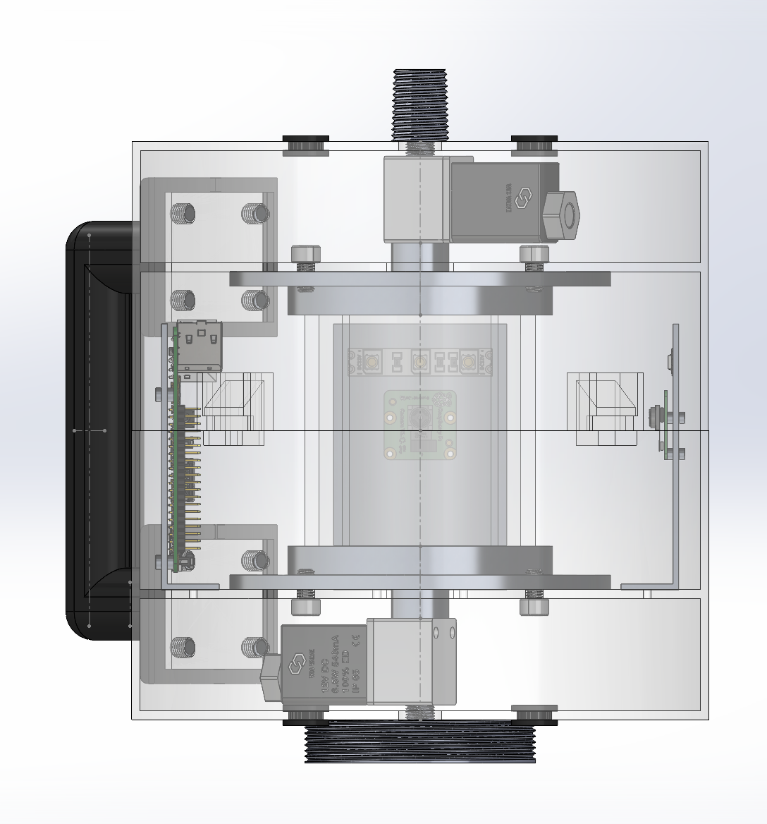
Differences from proof of concept
Second camera introduced instead
Alternate their white LEDs to light the unit
Ensures robust, cheaper product that still gains required diagnostic information.

